Slide 1


Total Aeronautical occurences
Presented By:
1. M.Andi Chamy-Solamalai College of Engineering-Civil Engineering

Slide 2
OUTLINE
○
Probelm Statement
Proposed Solution
System Approach
Algorithm & Deployment
Result
Conclusion
Future Scope
References
○ ○ ○ ○
○
○ ○

Slide 3
PROBLEM STATEMENT
This dataset comes from research by Civil Engineering department.
The aim of the study is to determine.This study seeks to improve aviation safety by understanding patterns and contributing factors across a wide range of aeronautical occurrences

Slide 4
PROPOSED SOLUTION
Setting Parameters:
1.Data Collection and Aggregation
2.Data Cleaning and Quality Assurance
3.Exploratory Data Analysis (EDA)
4.Risk Factor Identification
5.Root Cause Analysis
6.Safety Enhancements and Recommendations
7.Continuous Monitoring and Feedback Loop

Slide 5
SYSTEM APPROACH
Building the proposed solution would involve a combination of data processing,feature engineering,and machine learning. Here are the key system and library requriements.
System Requirements:
1.Hardaware:
A computer with sufficent processing power,perferably wwith multiple cores or a GPU for faster traning of machine learning models.
Adequate RAm to handke the size of the saraset and computational requriments.
2. Software:
An operating syatem compatible with the requrired machine learning libraries(eg., Windowa=s, linux,macsOS).

Slide 6
ALGORITHM & DEPLOYMENT
Total Aeronautical Occurances
Total Aeronautical Occurrences refer to a broad category of events and incidents related to aviation. These occurrences encompass both accidents and incidents, with the primary focus on safety analysis and improvement.
Categories of Occurrences:
System/Component Failure or Malfunction (Non-Powerplant) (SCF-NP)
Loss of Control-Inflight (LOC-I)
Controlled Flight Into or Toward Terrain (CFIT)
Collision with Obstacle(s) During Take-off and Landing (CTOL)

Slide 7
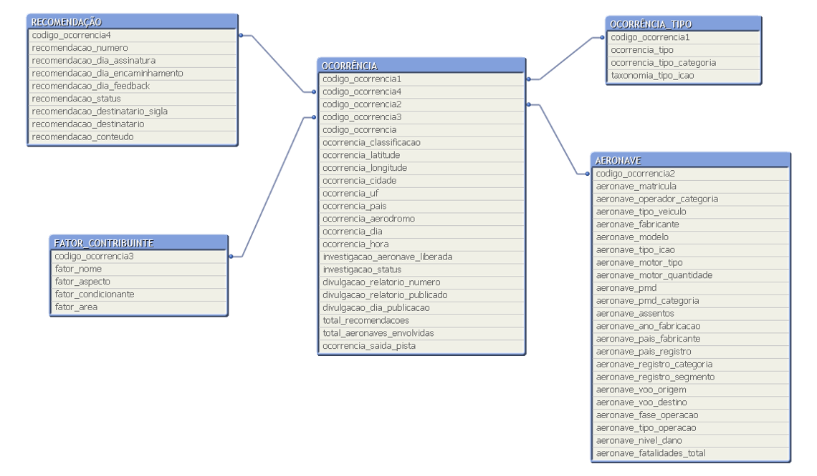
RESULT

Slide 8
CONCLUSION
This help make the world run smoother by designing new and safe technology for everyday people to use.
Almost everyone will fly on an airplane at some poit in their life and some people even fly everyday.

Slide 9
FUTURE SCOPE
The future aeronautical is new propulsion systems , advanced lightweight materials and cutting edge aerodynamic designs.

Slide 10
REFERENCES
https://www.kaggle.com/datasets/afumetto/3dprinter

Slide 11
THANK YOU

